Slide 1
GIT Commit and Jira Integration
Fusemachines Nepal

Slide 2
ROAD TO 2K
Improve process for onboarding of new clients Improve service delivery model and collaboration Organize technology operations, career framework and incentive framework Improve visibility of engineering team

Slide 3
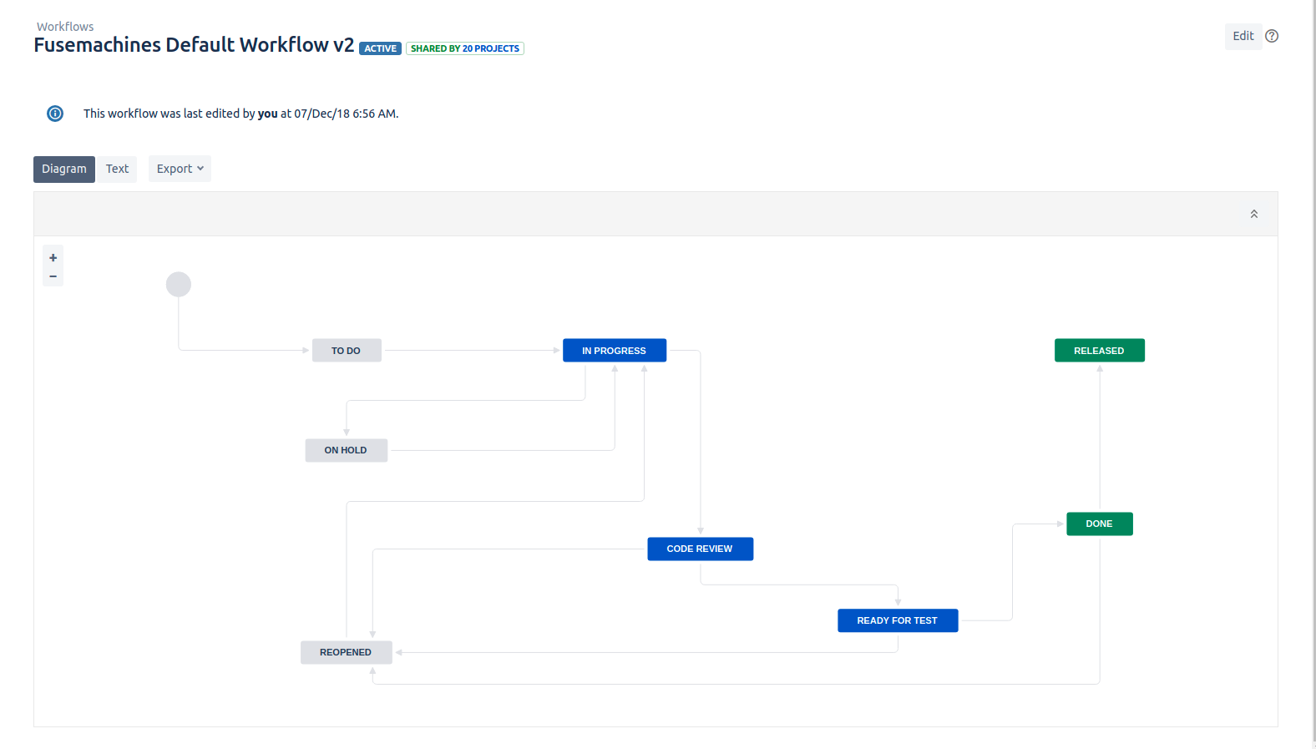
Jira Workflow

Slide 4
Jira Basics - Issue Types and Project Components
Issue Types :-
Epic
Story
Task
Sub-task
Bug
Improvement
Spike
Component:-
QA
DevOps
Design
Frontend
Backend
AI

Slide 5
Jira Basics - Boards
Scrum Board
Kanban Board

Slide 6
Git Basics
Commit
Pull
Push
Merge
Pull request

Slide 7
GIT branching model
Branch naming convention - TICKET ID from Jira
WHY?

Slide 8
Demo
Branching model
Git commit message conventions
Automating Jira Tickets For Developers

